Slide 1
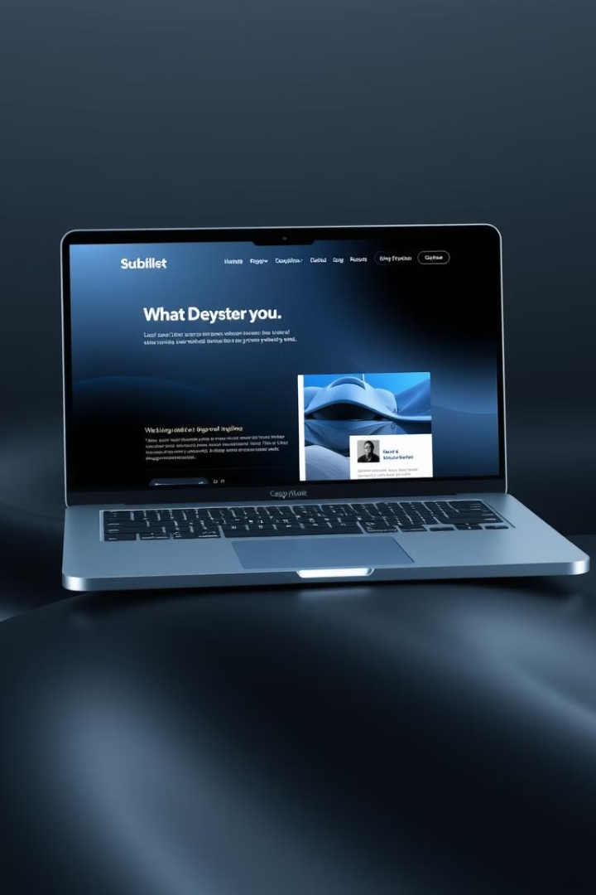
DesignDeck: Dark & Light Mode Showcase
Welcome to the DesignDeck presentation, where we'll explore the seamless integration of dark and light mode in our versatile UI component library. Join us as we delve into the key features, showcase its user-friendly design,.

Slide 2
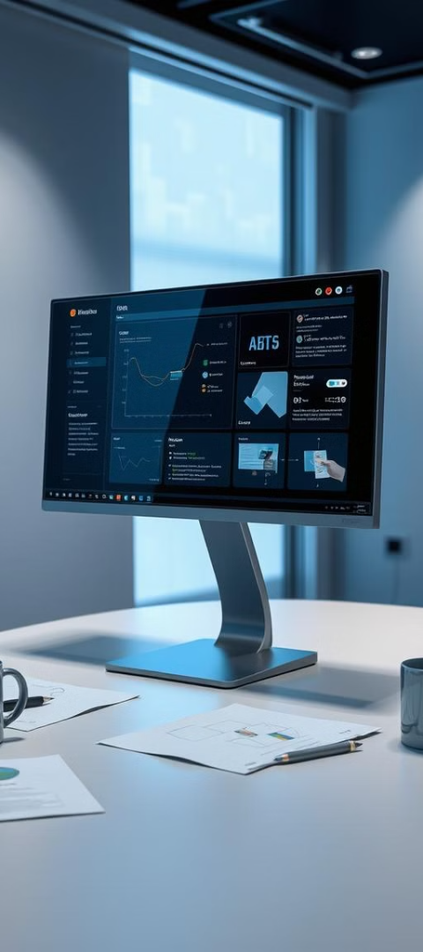



Weekly progress of
DesignDeck
UI Design Complete
Frontend Development In Progress
Key Pages in Progress
Profile page for other users, Project Upload Page,
Project view page etc…

Slide 3

Phase Completion: UI Design
1
The UI design phase is now complete.
2
The main principles focused on user needs, easy access for everyone, and a uniform design.
3
The design system encompasses typography, color palettes, and UI elements.
4
Examples include bright and attractive colors, easy-to-read fonts, and a well-organized set of design elements.

Slide 4
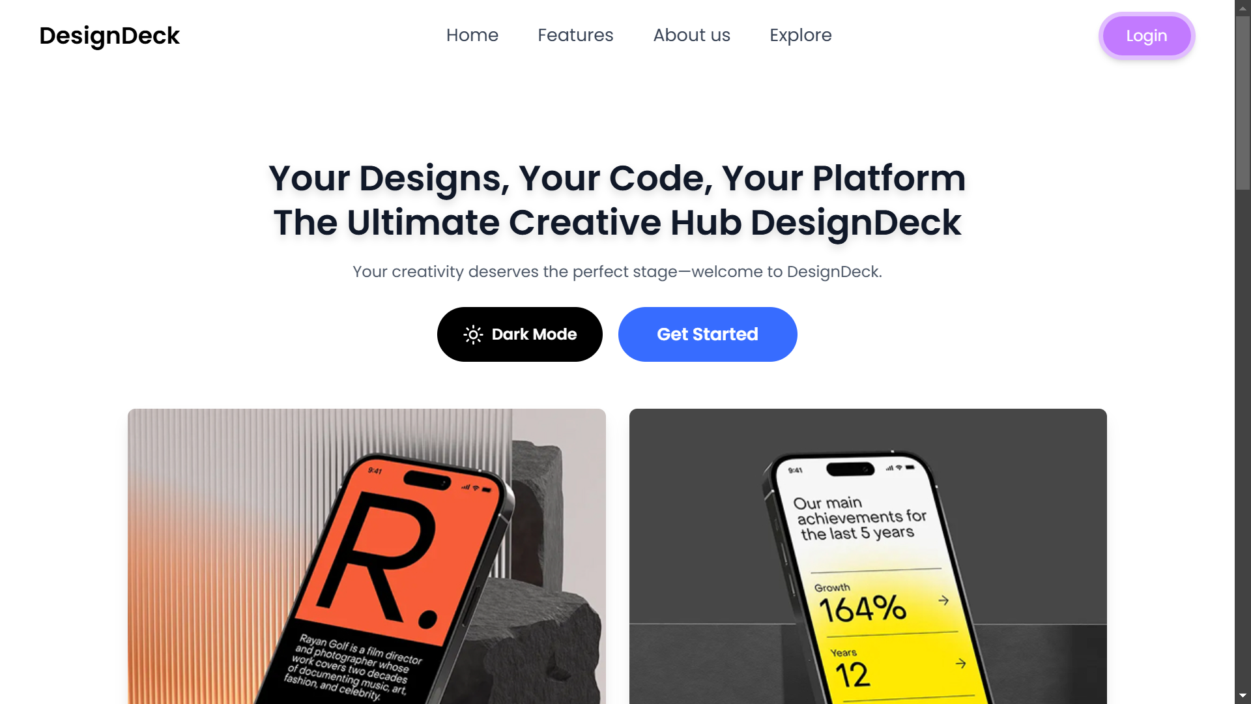
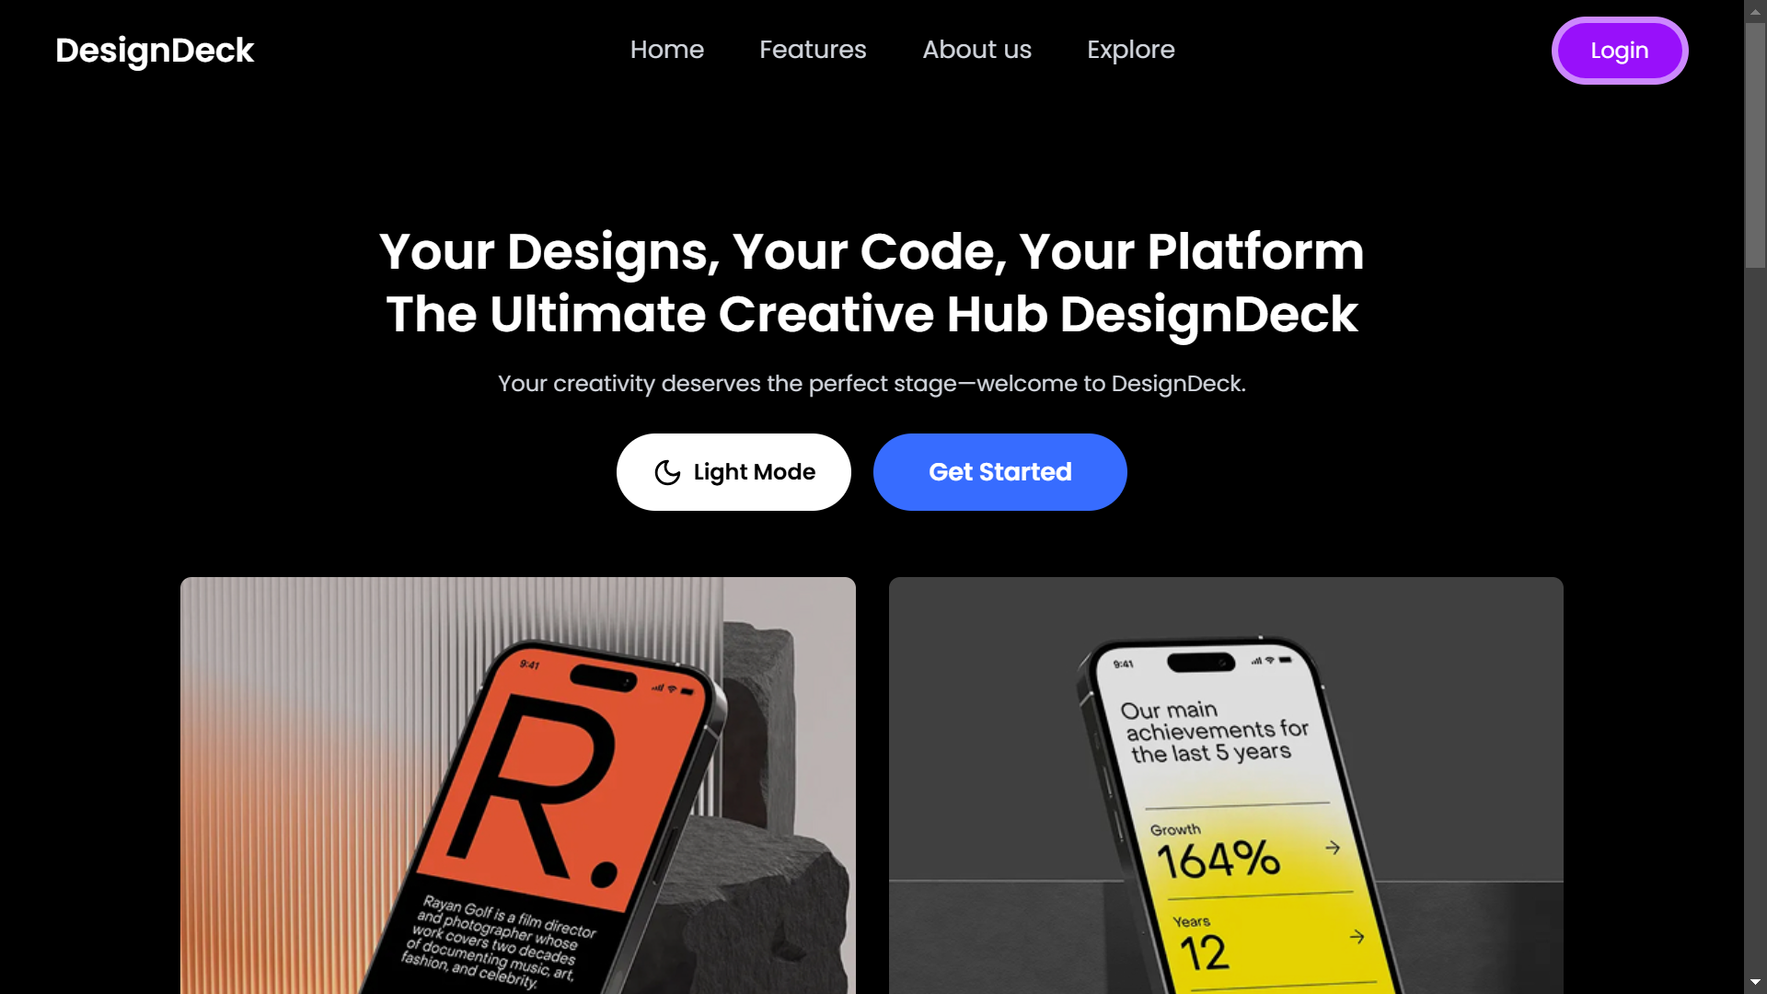
UI/UX Showcase: Dark & Light Mode
Light Mode
Dark Mode

Slide 5
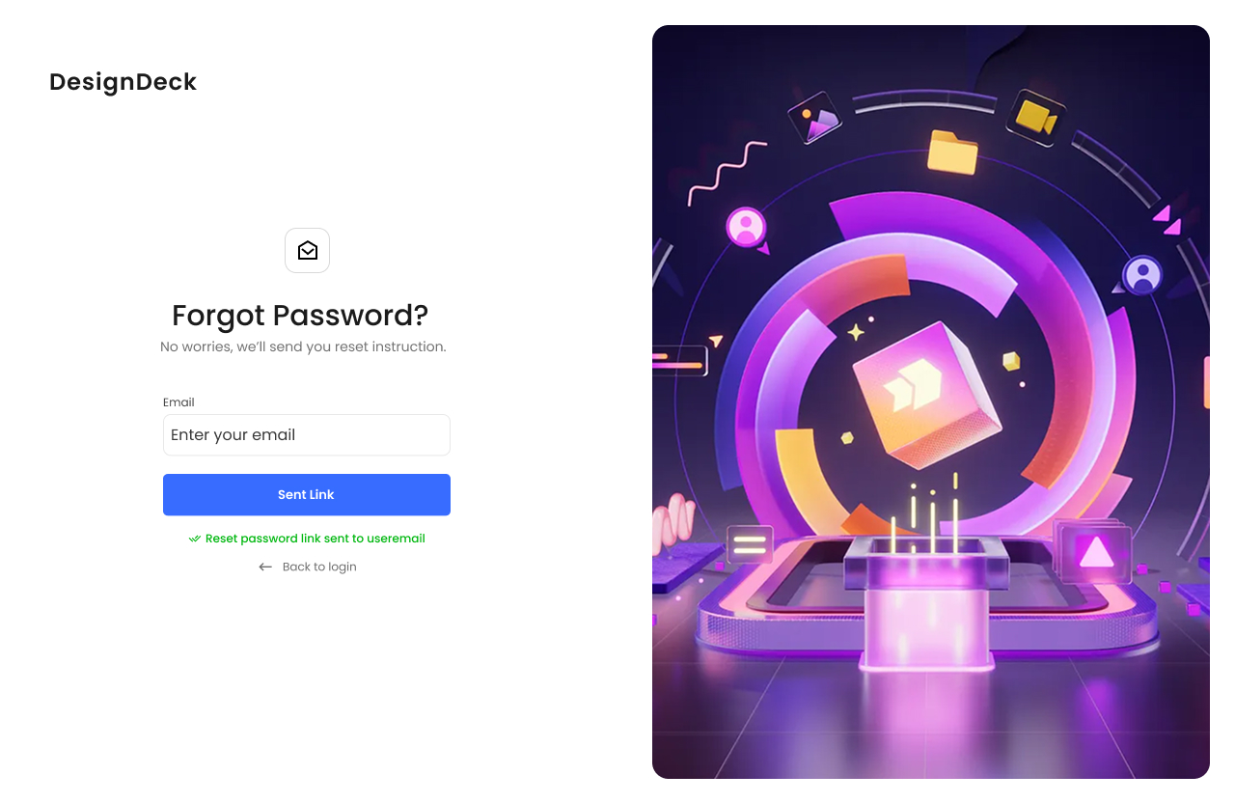
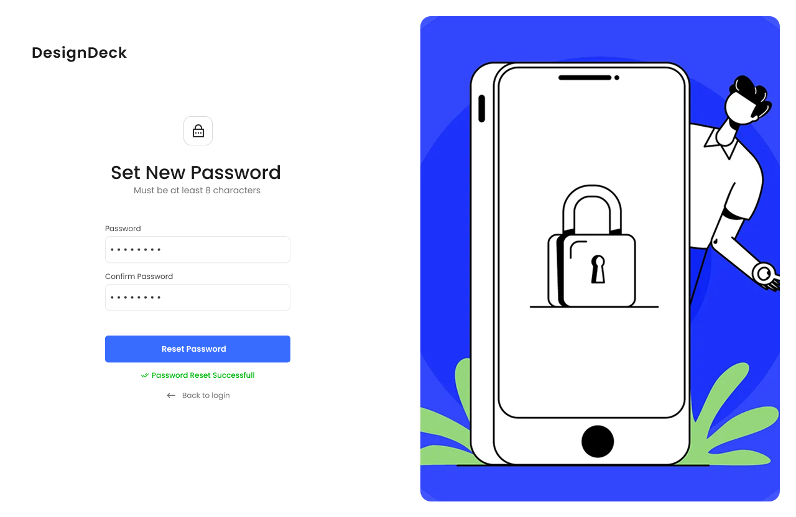
User Interface Screenshots
Sent Link page
Forgot password page

Slide 6
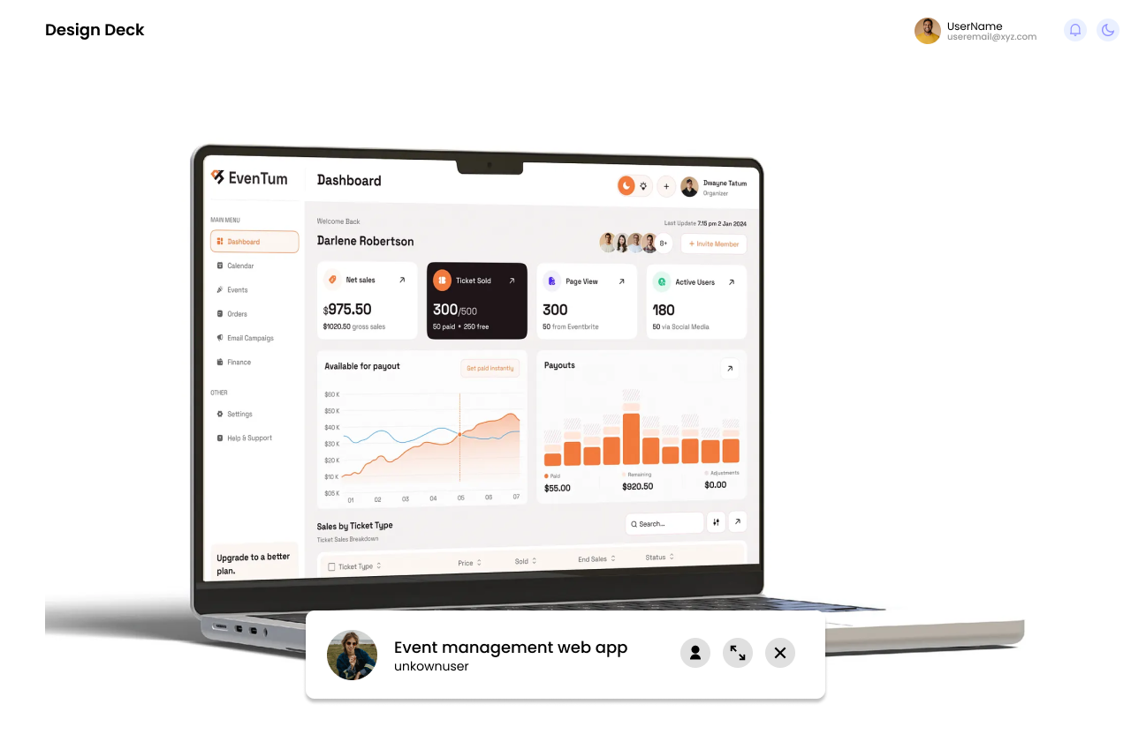
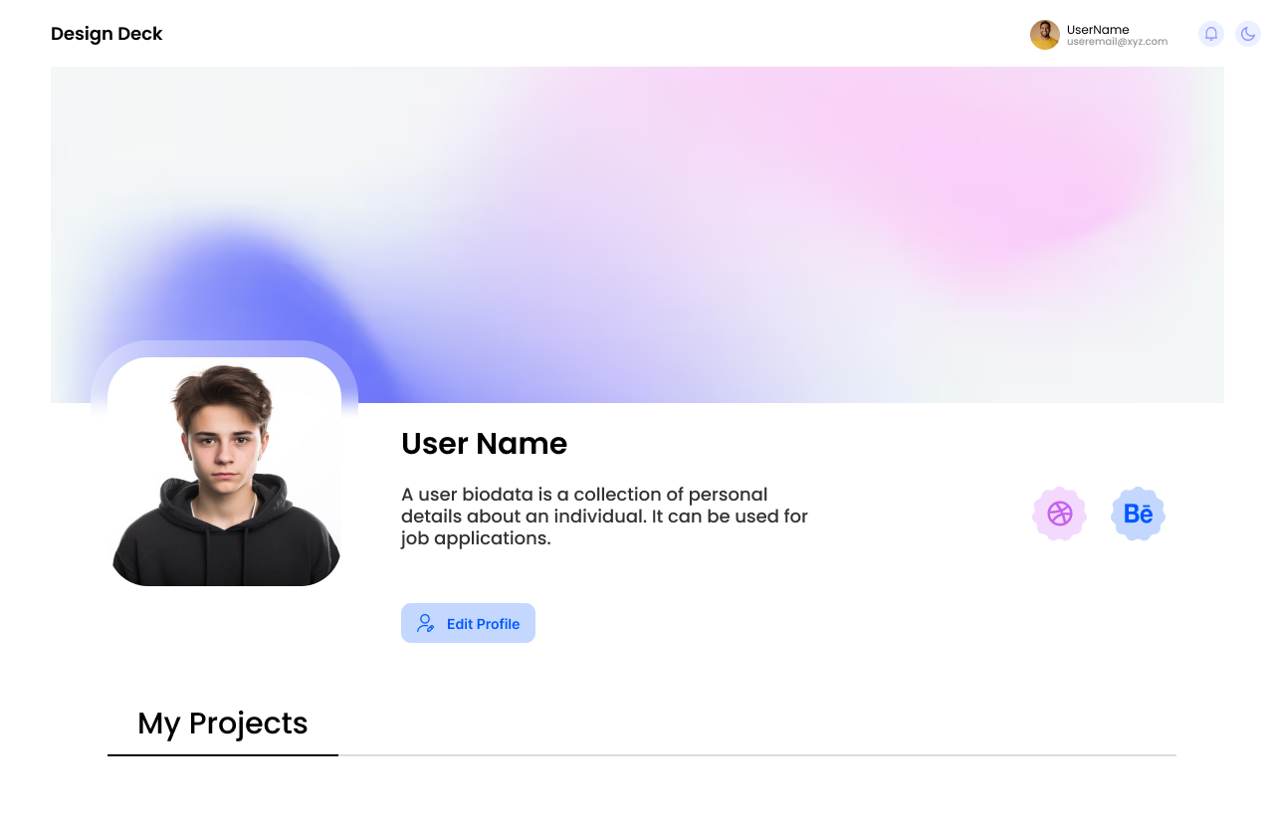
User Interface Screenshots
Particular Project Show Page
Profile page for user

Slide 7
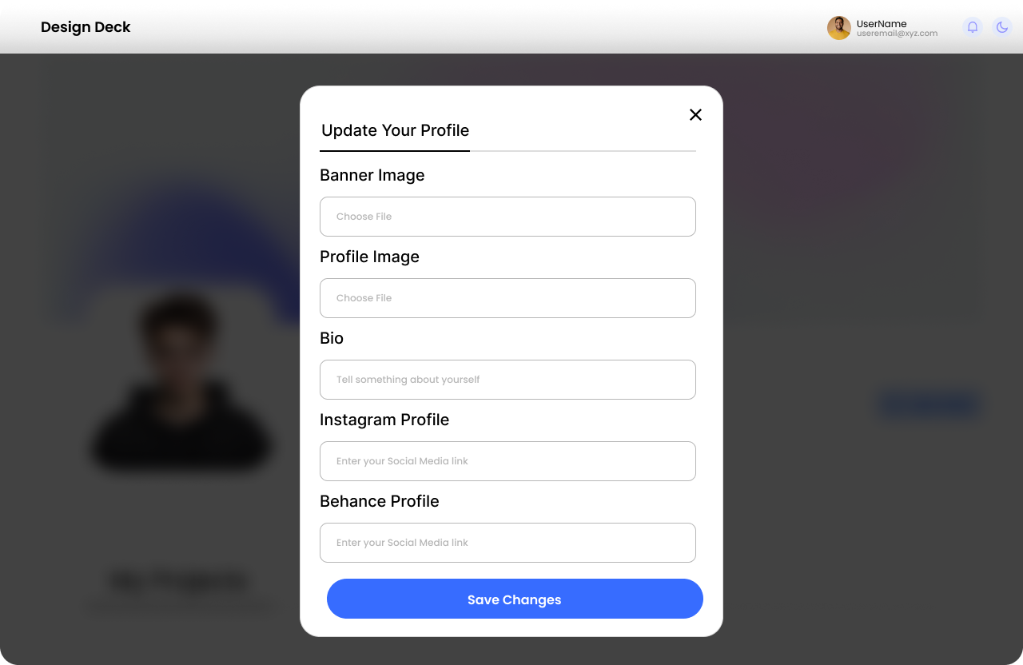
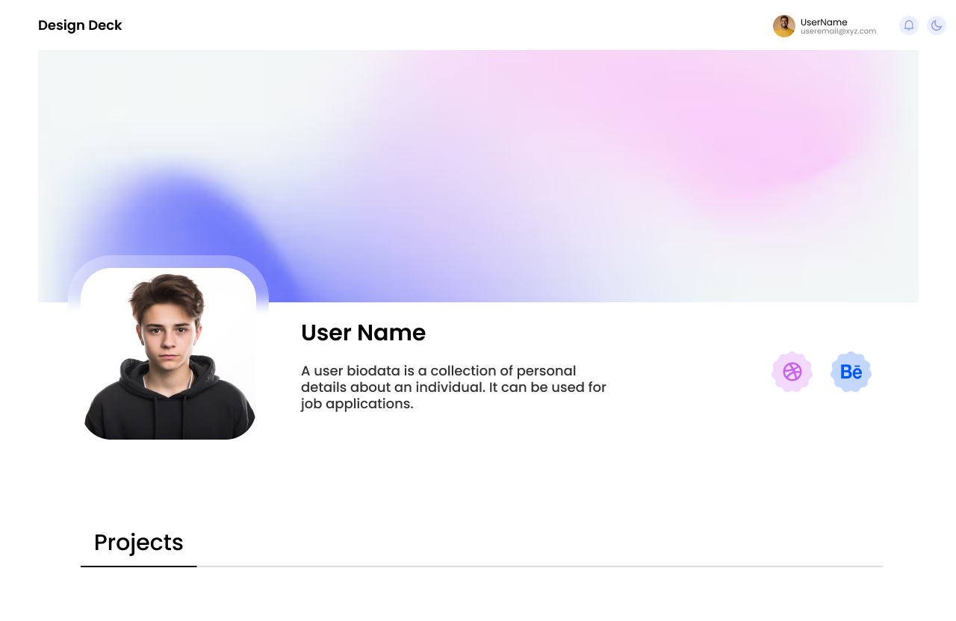
User Interface Screenshots
Edit Profile Page
Profile Page for others users

Slide 8
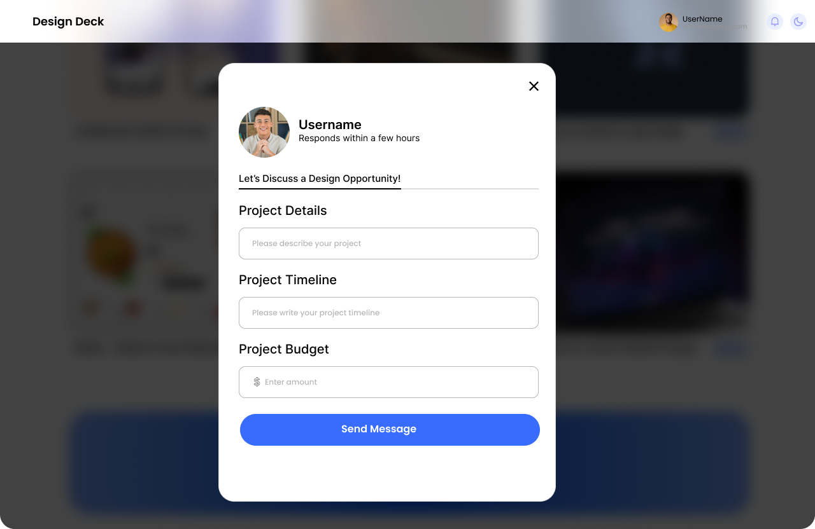
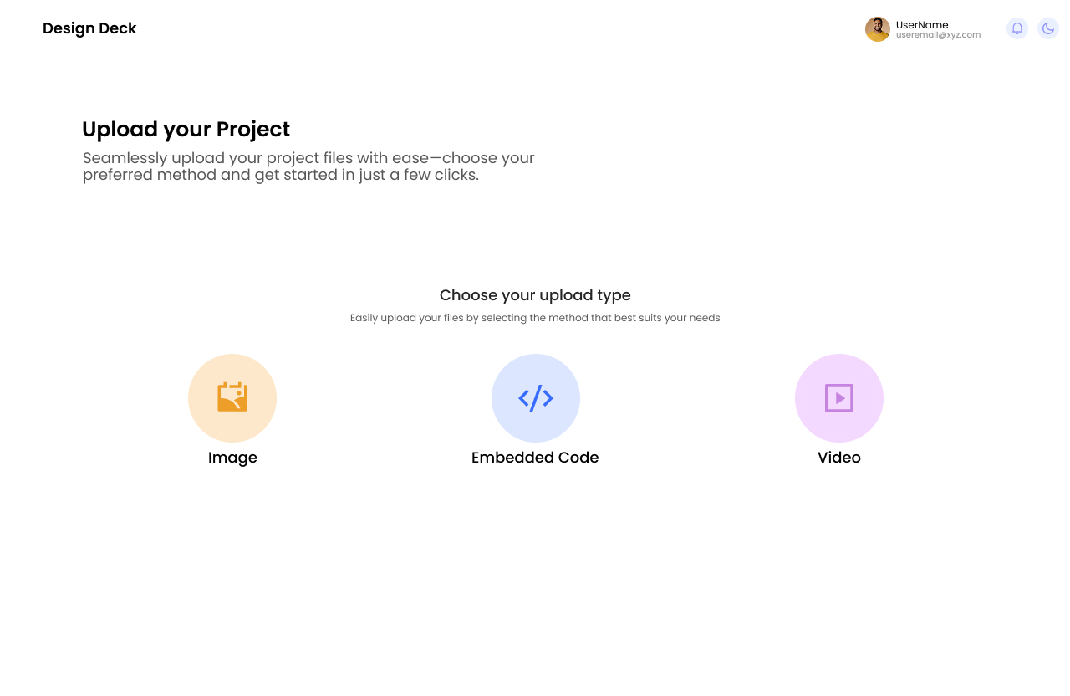
User Interface Screenshots
Contact to other user
Upload Project Page

Slide 9
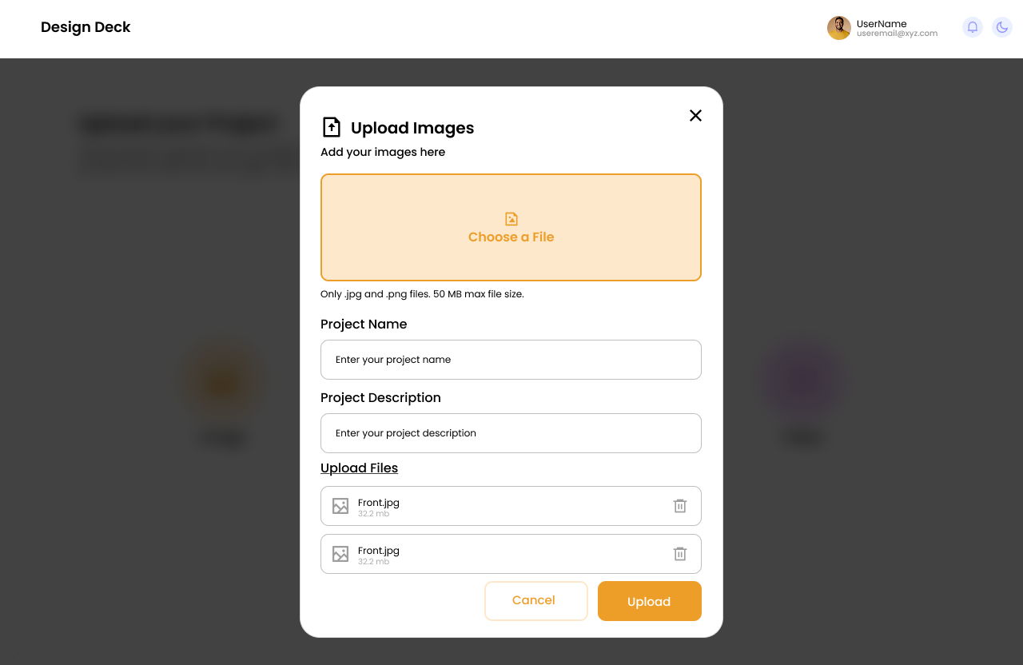
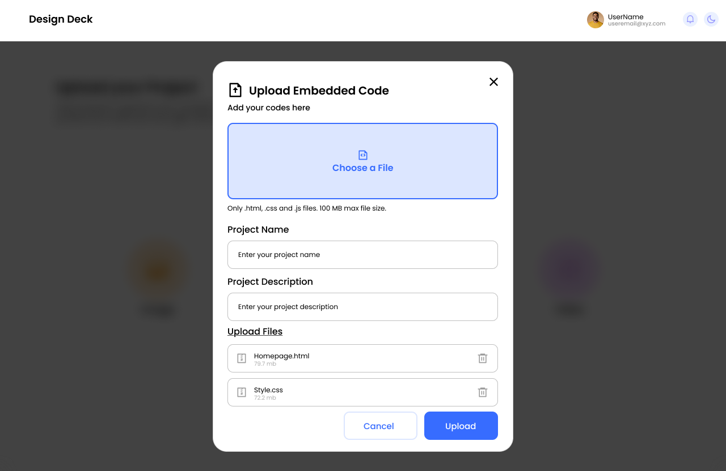
User Interface Screenshots
Image Upload Page
Embedded code Upload Page

Slide 10
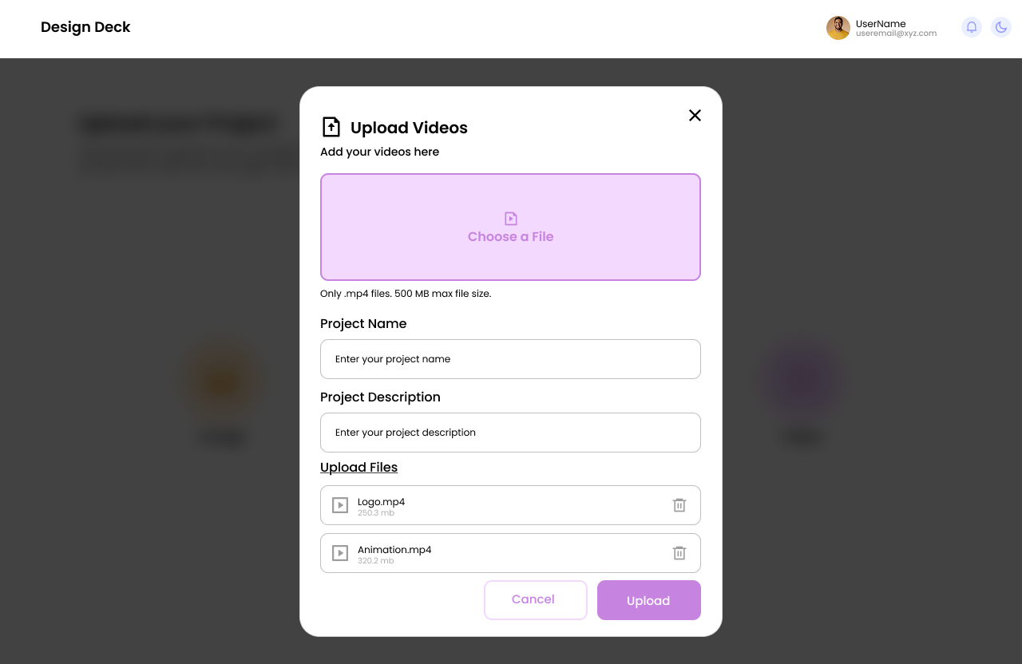
User Interface Screenshots
Video Upload Page

Slide 11
Starting Frontend Development
Frontend development focuses on creating visually appealing and interactive web applications. HTML structures the content, Tailwind CSS provides a flexible and responsive design, JavaScript adds dynamic functionality, and React helps build efficient, reusable components. These technologies work together to create modern, fast, and user-friendly websites with a seamless user experience.

Slide 12
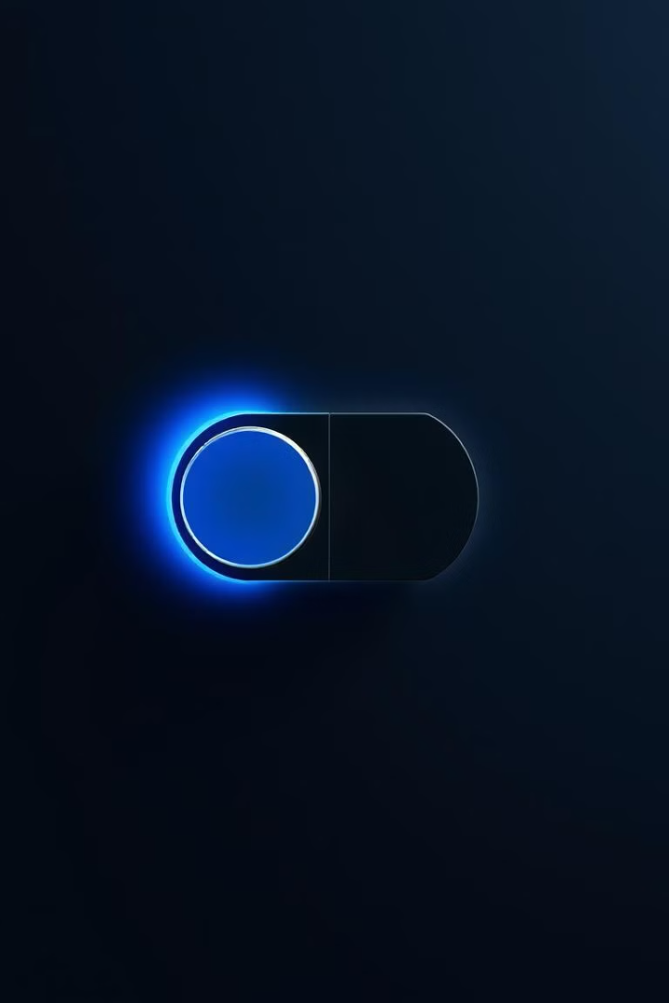
Key Features: Theme Toggling
Theme Toggling
DesignDeck seamlessly switches between dark and light modes with a simple click. It uses React Context API for global theme state, stores user preferences in local storage, and dynamically applies Tailwind CSS classes based on the selected theme.

Slide 13
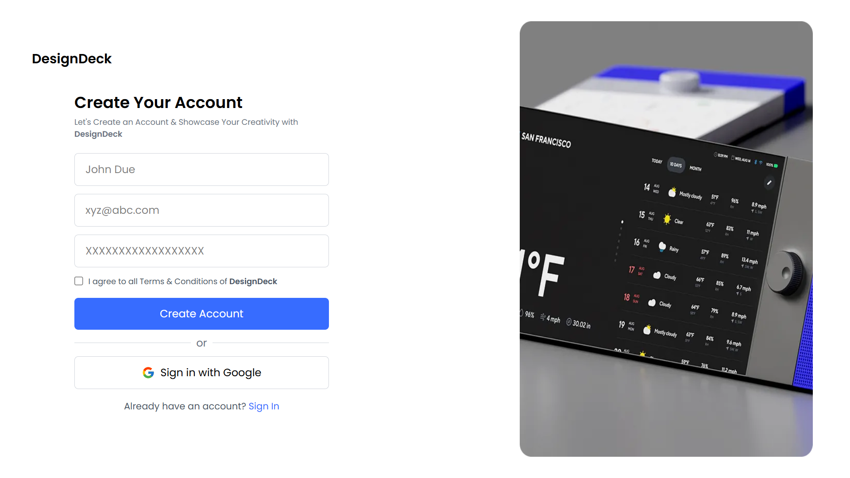
Screenshot Showcase : Frontend Development
Landing Page
Signup Page

Slide 14
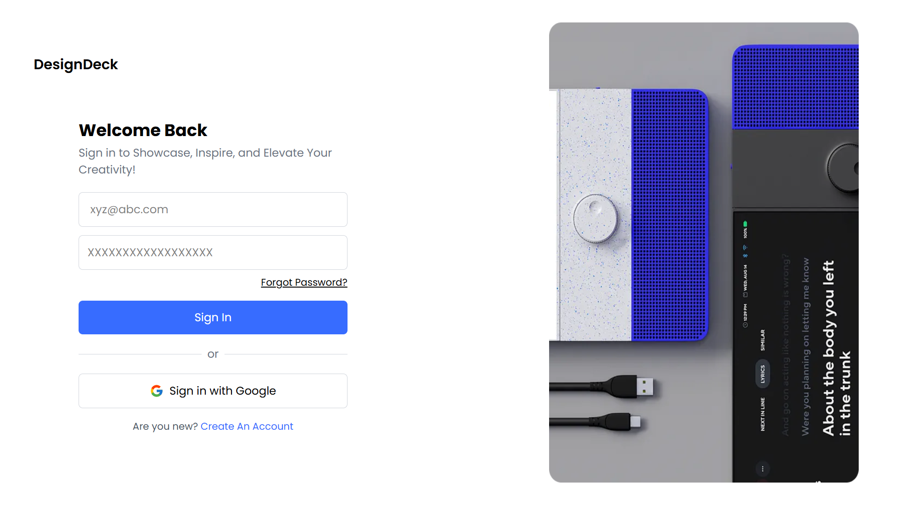
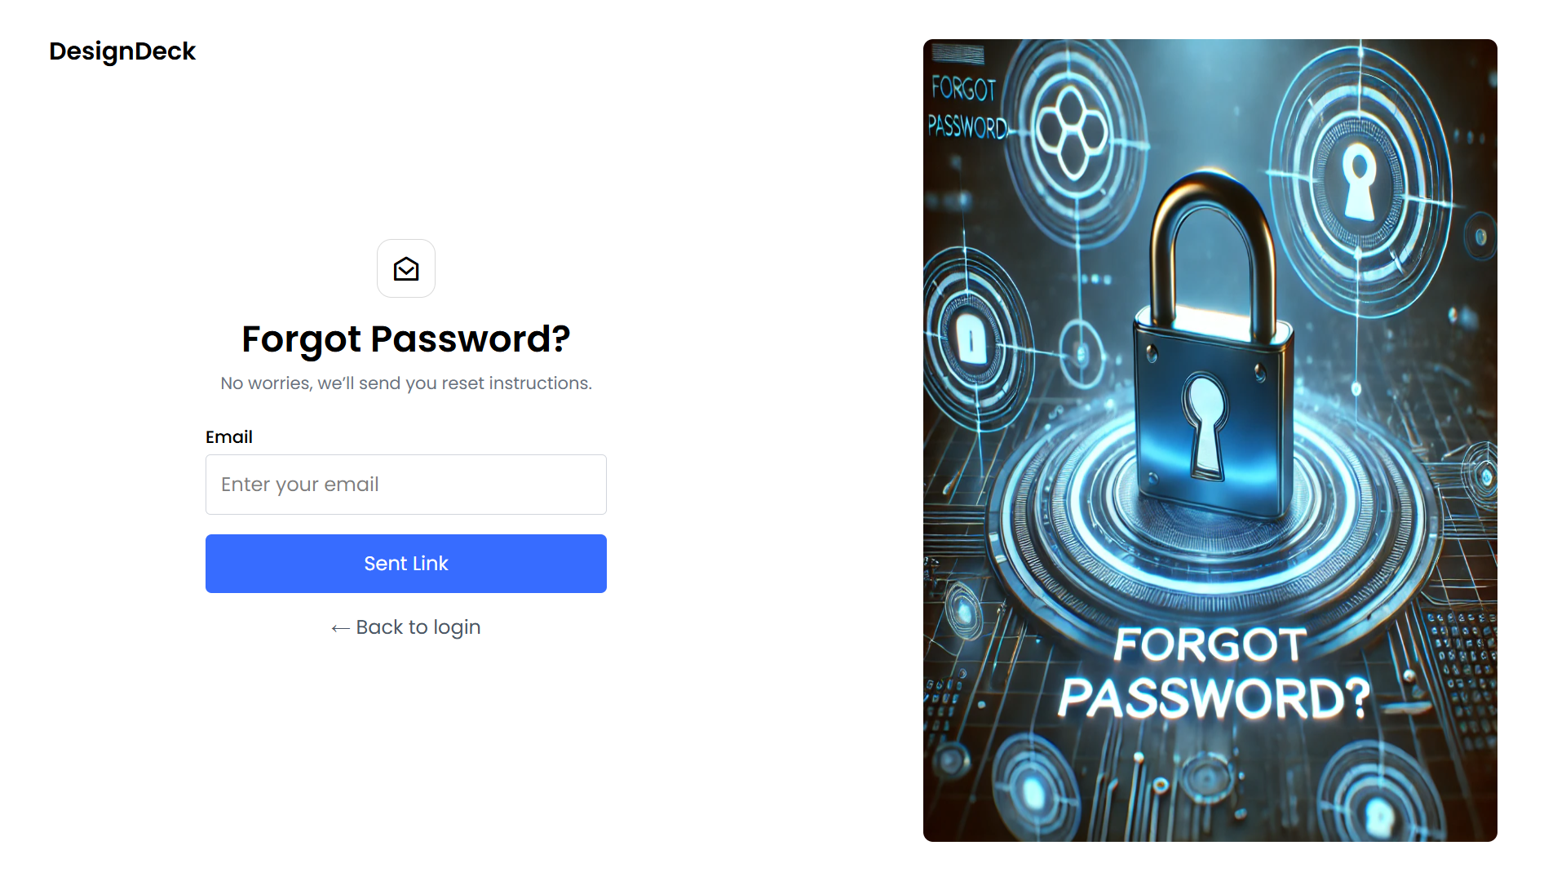
Screenshot Showcase : Frontend Development
Signin Page
Sent link page

Slide 15
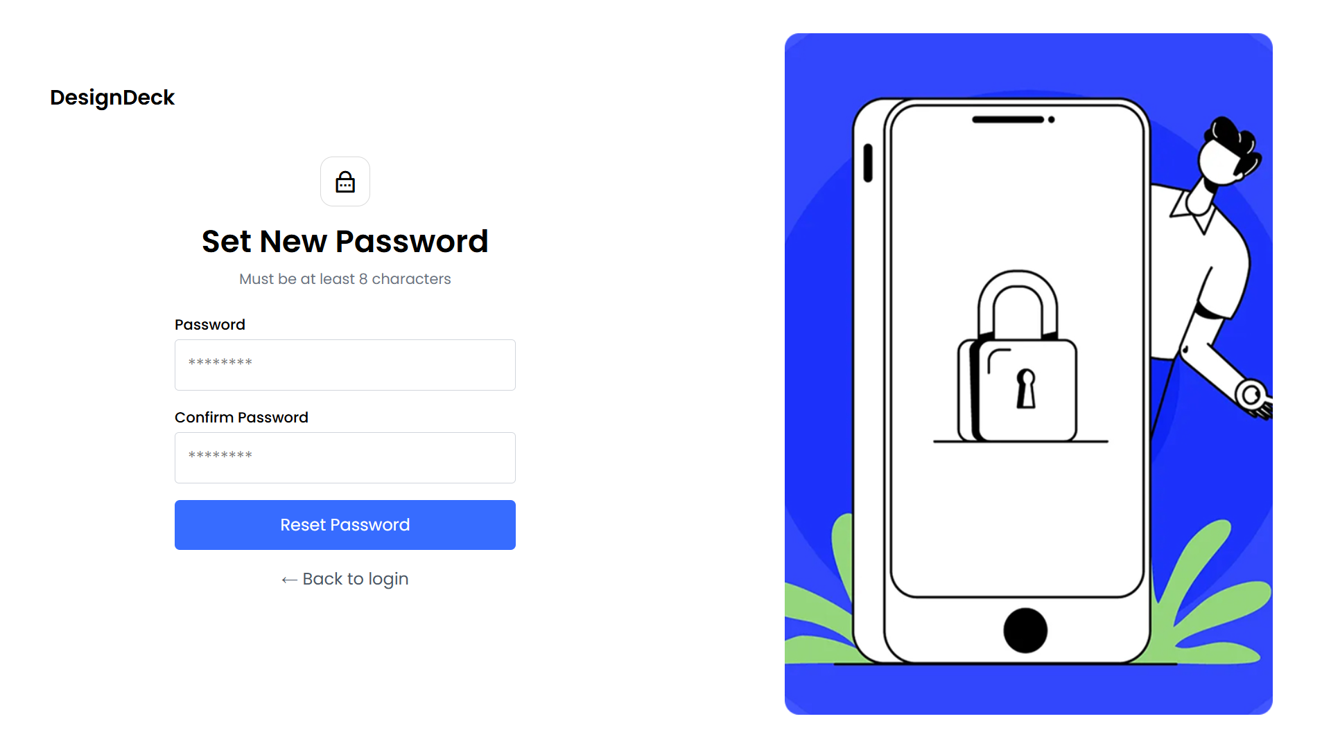
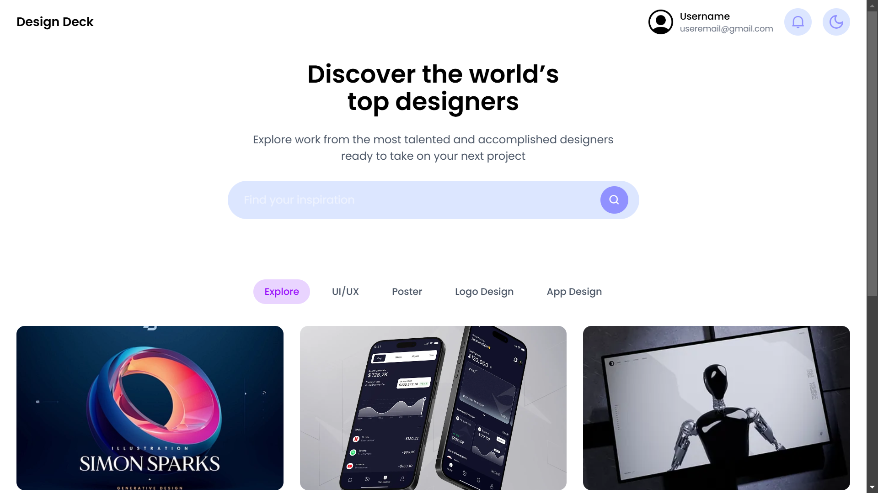
Screenshot Showcase : Frontend Development
Forgot Password page
Dashboard

Slide 16
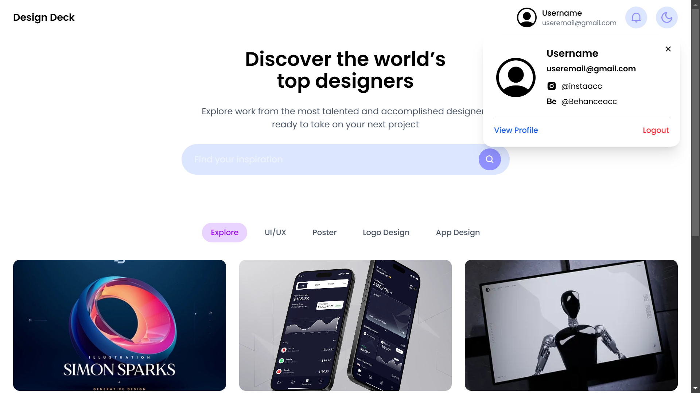
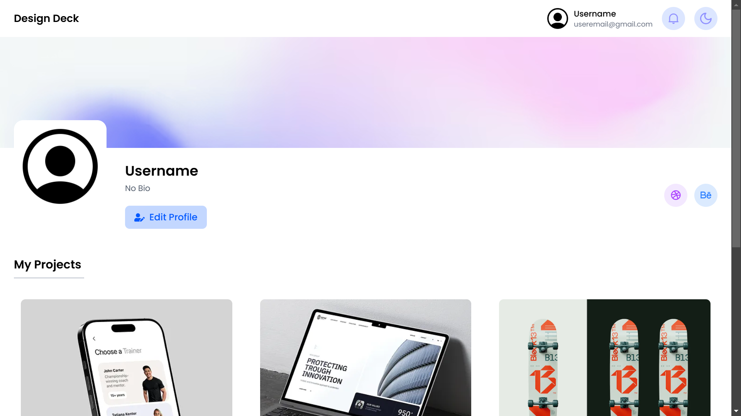
Screenshot Showcase : Frontend Development
Dashboard With Profile Popup
Profile Page

Slide 17
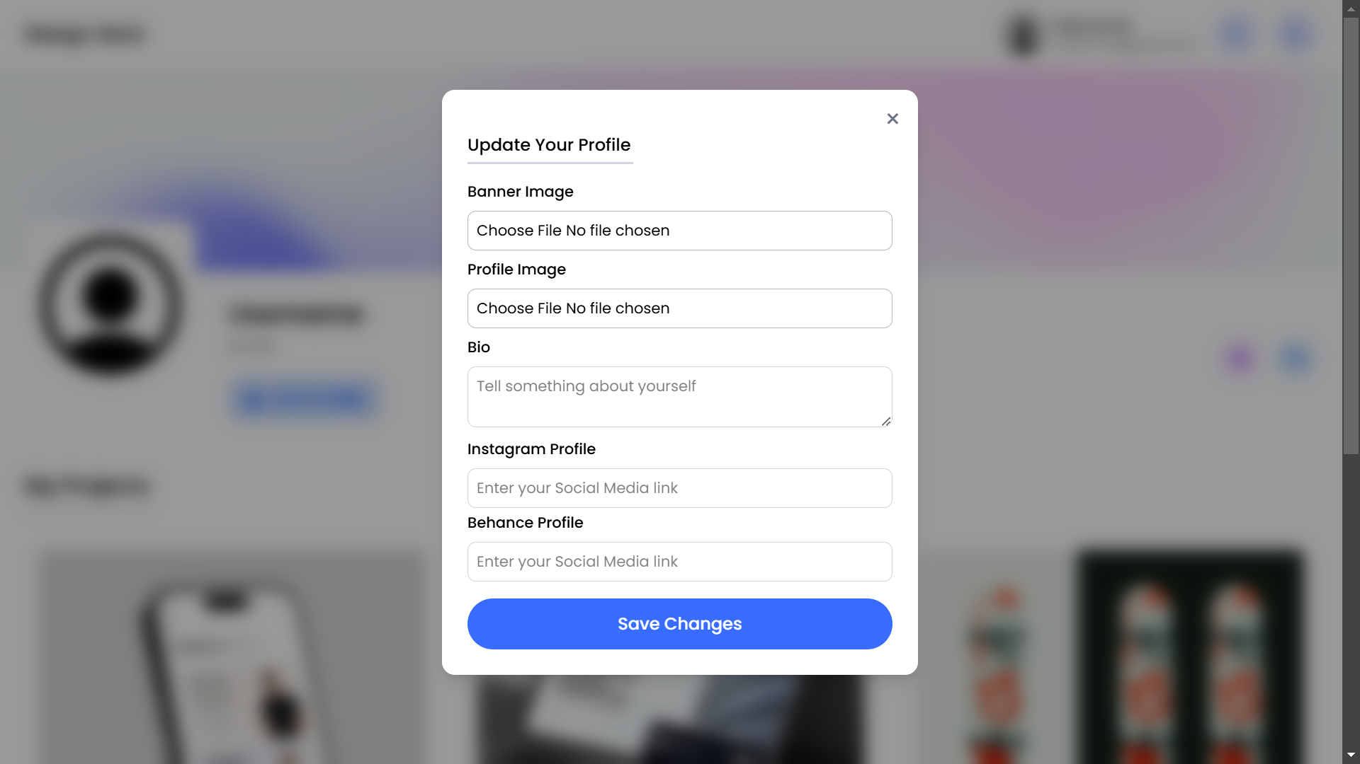
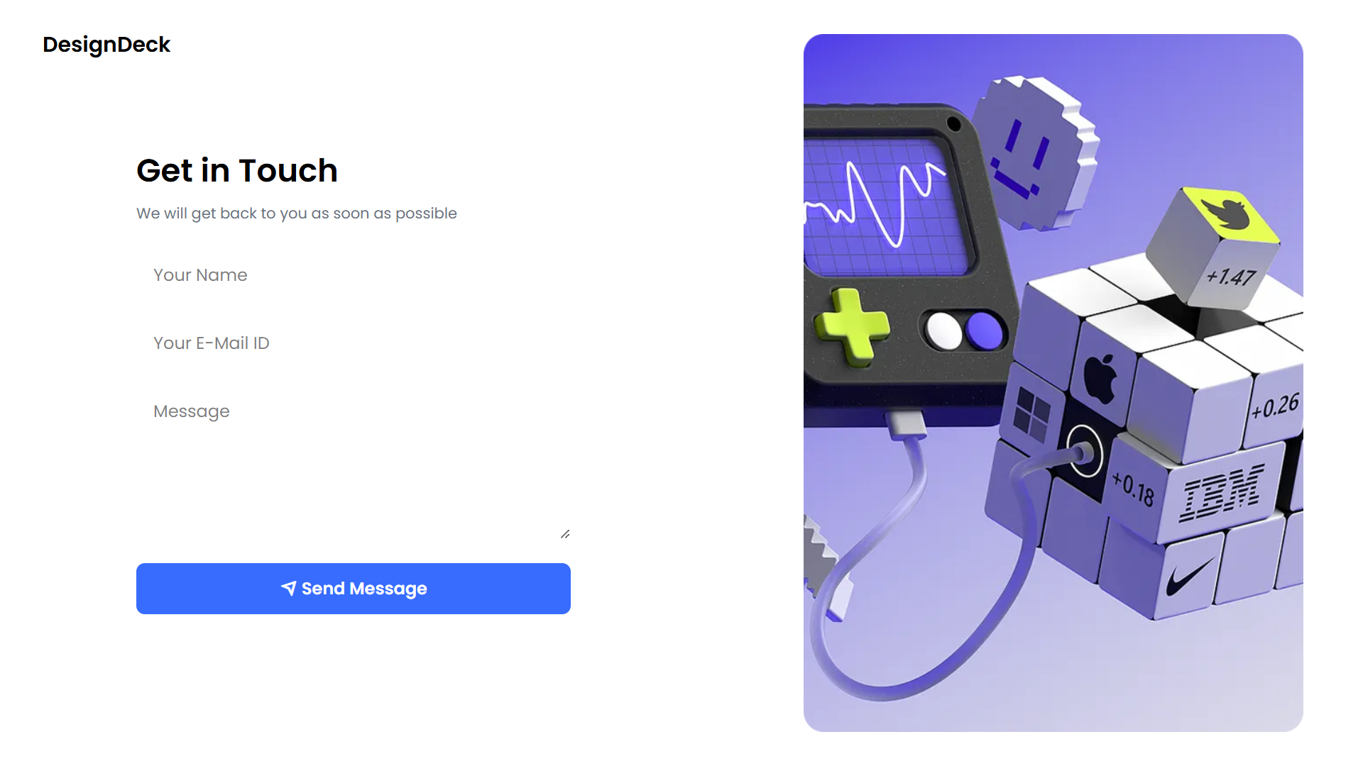
Screenshot Showcase : Frontend Development
Edit profile popup
Contact us page

Slide 18



Next step for DesignDeck
Frontend Development Completed
Connecting Frontend & Backend
Thorough Testing
Ensure functionality, performance, and responsiveness.
Actively build the website's frontend.
Integrate frontend with the backend.

